Slide 1



Random Variables
DR. HEENA SHARMA
E6398
ASSISTANT PROFESSOR
CSE
DISCOVER . LEARN . EMPOWER

Slide 2
Definition and Basic Concepts
The following definitions and terms are used in studying the theory of probability distribution.
Random Variable: A variable whose value is a number determined by the outcome of a random experiment is called a random variable.
There are two types of random variable in statistics such as follows:
Discrete Random Variable
Continuous Random Variable

Slide 3
Discrete Random Variable:
If a random variable takes only a finite or a countable number of values, it is called a discrete random variable.
Example:
When 3 coins are tossed, the number of heads obtained is the random variable C assumes the value 0, 1, 2, 3 which from a countable set. Such a variable is a discrete random variable.

Slide 4
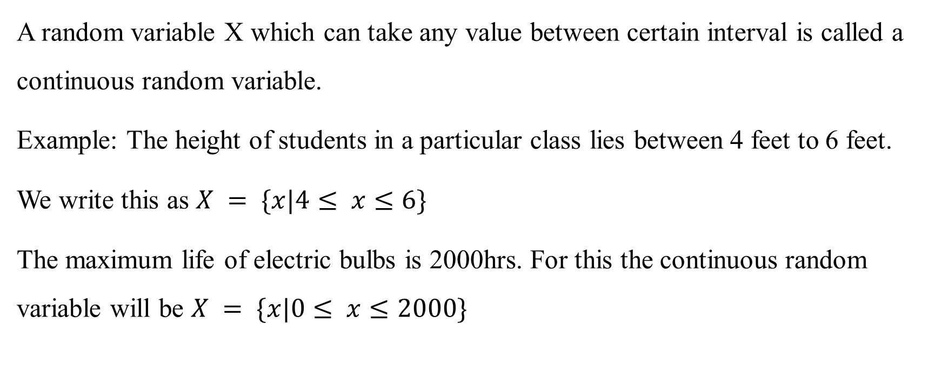
Continuous Random Variable:
A random variable X which can take any value between certain interval is called a continuous random variable.
Example: The height of students in a particular class lies between 4 feet to 6 feet.
We write this as $X = \{x|4≤ x≤6\}$
The maximum life of electric bulbs is 2000hrs. For this the continuous random variable will be $X = \{x|0≤ x≤2000\}$

Slide 5
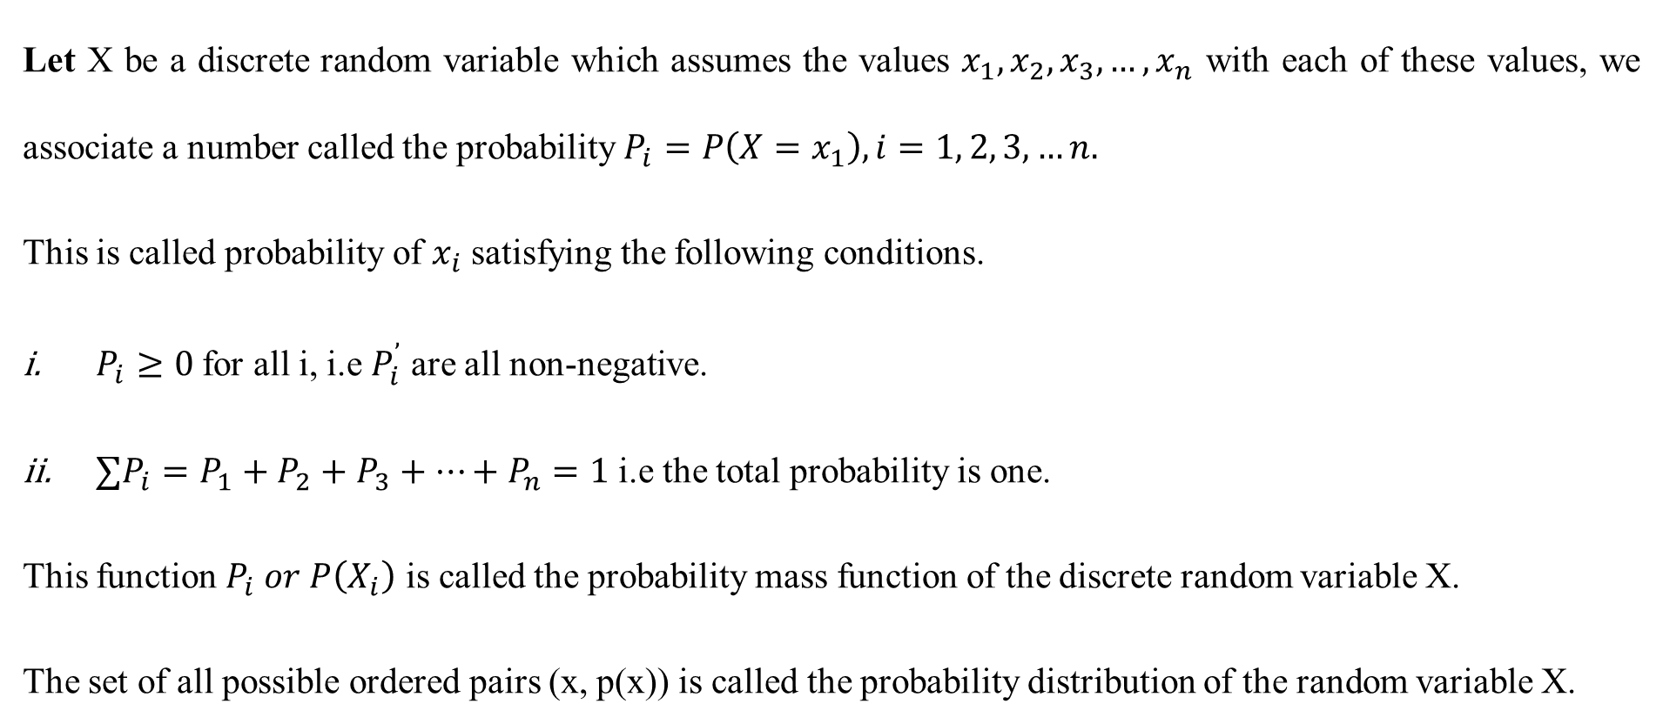
Probability Mass Function:
Let X be a discrete random variable which assumes the values $x_{1}, x_{2}, x_{3}, …, x_{n}$ with each of these values, we associate a number called the probability $P_{i}=P\left(X=x_{1}\right), i=1, 2, 3, …n.$
This is called probability of $x_{i}$ satisfying the following conditions.
$P_{i}≥0$ for all i, i.e $P_{i}^{’}$ are all non-negative.
$∑P_{i}=P_{1}+P_{2}+P_{3}+…+P_{n}=1$ i.e the total probability is one.
This function $P_{i} or P\left(X_{i}\right)$ is called the probability mass function of the discrete random variable X.
The set of all possible ordered pairs (x, p(x)) is called the probability distribution of the random variable X.

Slide 6
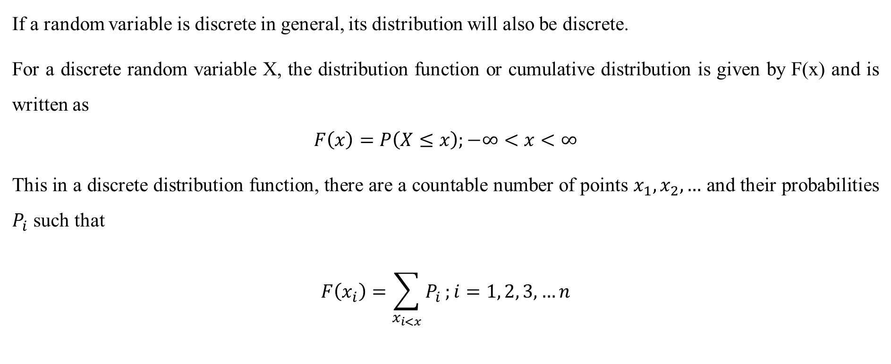
Discrete Probability Distribution
If a random variable is discrete in general, its distribution will also be discrete.
For a discrete random variable X, the distribution function or cumulative distribution is given by F(x) and is written as
$$F\left(x\right)=P\left(X≤x\right);−∞<x<∞$$
This in a discrete distribution function, there are a countable number of points $x_{1},x_{2}, …$ and their probabilities $P_{i}$ such that
$$F\left(x_{i}\right)=\sum_{x_{i<x}}{P_{i}};i=1, 2, 3, …n$$

Slide 7
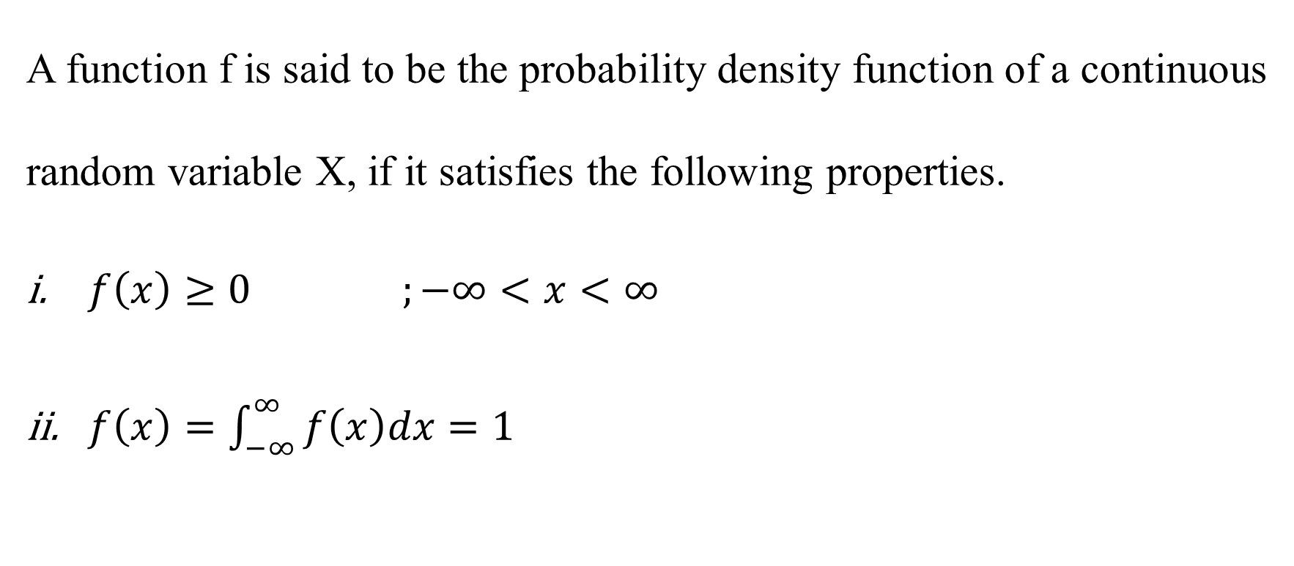
Probability Density Function (pdf):
A function f is said to be the probability density function of a continuous random variable X, if it satisfies the following properties.
$f\left(x\right)≥0 ;−∞<x<∞$
$f\left(x\right)=\int_{−∞}^{∞ }{f\left(x\right)dx}=1$

Slide 8
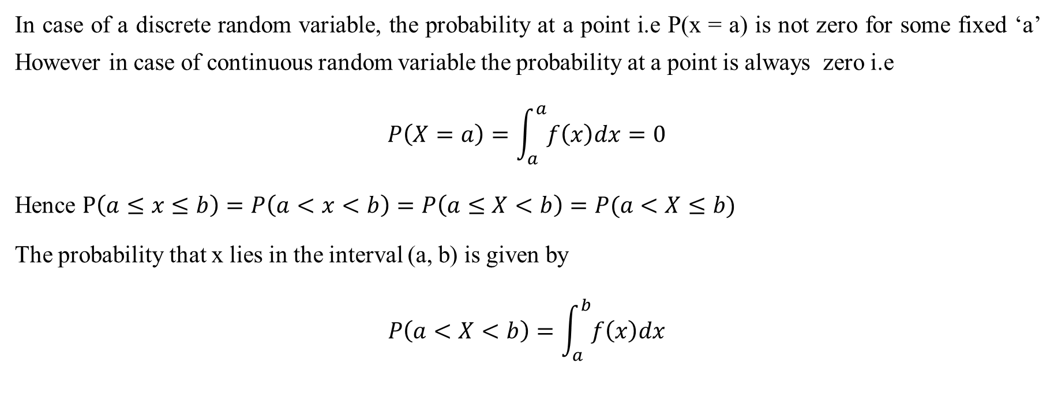
Remark:
In case of a discrete random variable, the probability at a point i.e P(x = a) is not zero for some fixed ‘a’ However in case of continuous random variable the probability at a point is always zero i.e
$$P\left(X=a\right)=\int_{a}^{a}{f\left(x\right)dx=0}$$
Hence $P\left(a≤x≤b\right)=P\left(a<x<b\right)=P\left(a≤X<b\right)=P(a<X≤b)$
The probability that x lies in the interval (a, b) is given by
$$P\left(a<X<b\right)=\int_{a}^{b}{f\left(x\right)dx}$$

Slide 9
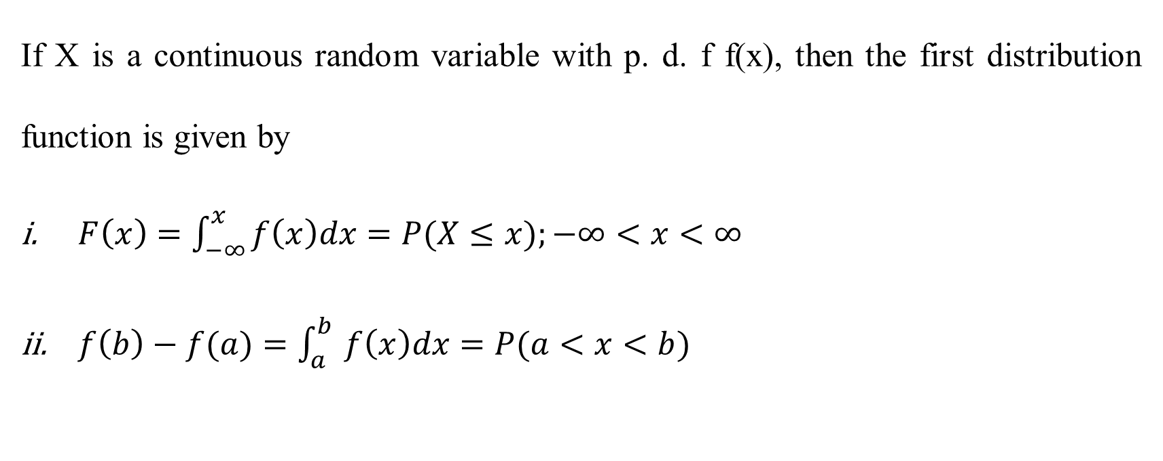
Distribution Function for continuous random variable
If X is a continuous random variable with p. d. f f(x), then the first distribution function is given by
$F\left(x\right)=\int_{−∞}^{x }{f\left(x\right)dx}=P(X≤x);−∞<x<∞$
$f\left(b\right)−f(a)=\int_{a}^{b }{f\left(x\right)dx}=P(a<x<b)$

Slide 10
THANKS FOR PAYING ATTENTION
Please Send Your Queries on:
e-Mail: heena.e6398@cumail.in

